Slide 1
Online adaptive content personalisation
Jonathan Wasson 8/5/2014
Supervisor: Benjamin Rosman

Slide 2
Motivation
What does a designer do when the interface of a device or an application does not suit every user?
How does a designer keep users interested when the game is either too difficult or too easy?
How does a designer simply keep the game interesting when players have a wide range of preferences?
Notes:
Intro: Talk about what you want to achieve.
Mention how important this is to industry.
Mention GTA 5’s massive worth, sold copies etc.

Slide 3

Interface adjustment
Adjust the interface so that the unskilled, inept or disabled don’t become frustrated. As well as to enhance the performance of all users.
Examples:
Kinect
Temple run
User interfaces for
the disabled
Notes:
Talk about making the interface easier for all users to use to optimize their performance

Slide 4

Difficulty Adjustment
Pitch the difficulty in ways that are friendly to the user.
Examples:
Dota 2
Dark souls
Goldilocks effect
Notes:
Keep the skill-level at their current level. Hard for skilled players and easy for the unskilled. Goldilocks implies keeping it at their level.
Gradual increase in difficulty or sharp changes

Slide 5
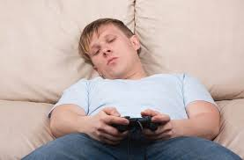
Personalisation
Adapt the games content in order to keep it interesting to the specific user. (i.e. Replayability)
Goal of research
Examples:
Left for Dead 2
Voice recognition
Notes:
MOST IMPORTANT. Focus of the presentation. SPEND MORE TIME ON THIS.
Personalize the content. Basically everything is about personalisation.
Unique content for each user
Left for dead: amount of zombies sent at you is pitched at your level.

Slide 6
Assumptions
Skill level can be quantified
Skill level can be inferred from user behaviour
Aspects of the game can be adjusted to affect the user experience

Slide 7
HYPOTHESES
The content and interface of a computer game can be automatically updated or changed
Adaptive content improves the users experience

Slide 8
Research
Research is Novel
Partially implemented
Research never been one before
We want to create a game that will adapt in real time to provide the best possible user experience.
To do this the game must:
Monitor the users’ actions
Be able to determine user skill-level
Update future content to cater to the specific user
Notes:
Design a game that can adapt to the users actions to best improve their experience and performance.

Slide 9
Experiment
We propose to create a scaled down simple game
Model the transitions and user actions
Determine the best fit for groups of users
Test both base version and adaptive version
Notes:
Mention that we are improving upon an existing method.
Tower defence is a game where players must defend a path
Monsters arrive in ‘waves’ and attempt to reach the end of the path
Players build towers along this path which fire upon monsters
Towers are built using money that the player earns through completing a wave
Several types of towers and monsters exist with varying properties
Score is determined by how many waves of monsters the user defeats before being overwhelmed

Slide 10
Experiment cont.
Independent variables:
Players skill level, Preference and play style (eg tower position)
Dependent variables:
Monster health, Monster type, Gold received, Monster speed, available towers etc. will be adjustable to suit the user
Notes:
Mention that we are improving upon an existing method.
To accomplish this we must monitor user actions in order to make decisions
An algorithm must be designed to run parallel to the game
Slide 11/12: (combine)
It sounds like you're building an algorithm from scratch. Again, this will seem like you're being overly ambitious. Instead state you're adapting an existing method, which does .... You use it by modelling the transitions and actions taken by different users, and determining the best it for new users.
You may want another slide describing the experimental procedure:
Have many users play the game, build models (training), and then test on different users. Compare users with and without the adapting content.
To speed up the research you may simulate the users, by varying certain parameters in their strategies.

Slide 11
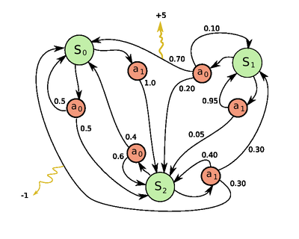
Implementation
The algorithm will create a user profile for each specific type of user when it is trained determined by their play styles.
Use Markov Decision Process
Reinforcement Learning to create MDP
Match actions to user types; i.e. Allowing the algorithm to determine the type of user.
Notes:
Mention benjamins research on interface adaptation.

Slide 12
Results and Testing
Look at user performance after playing a game and look at their associated skill level
Generate optimal strategies for each transition
Look at users’ performance after playing a game with the adaptive content
Compare results

Slide 13
Task | Time (Duration: weeks)
Finish Research Proposal | 2
Program Game | 1
Test users for each skill level and collect data | 1
Create Markov Decision Process for each skill level | 3
Finish algorithm to map transitions | 2
Test adaptive algorithm on each group and collect data | 1
Analyse and compare results to determine viability | 3

Slide 14
Conclusion
We hope to develop an algorithm in that will achieve the following:
Classify the user
Adapt the content of the game in real-time
Increase the enjoyment of the game
Make the game replayable

